Slide 1






Developer Survey 2019
Saqib Hussain
09-07-2022

Slide 2



OUTLINE
Executive Summary
Introduction
Methodology
Results
Visualization – Charts
Dashboard
Discussion
Findings & Implications
Conclusion
Appendix

Slide 3

EXECUTIVE SUMMARY
This survey explains skills and technologies need for people and business.
It’s necessary and essential for tech industry to know about:
The current market.
The most useful skills.
The future Software Development.
This presentation contains current/future usage and trends of Programing languages, Databases, Platforms and Webframes.
The aim of this presentation is to identify future skill requirements for businesses and developers

Slide 4

INTRODUCTION
The Purpose of this Presentation is to help Tech industry with the current and future skill requirements of individuals needed.
The presentation will help the IT industry to keep pace with the changing technologies and necessary actions to remain competitive.
Recommendations are based on the data.

Slide 5

METHODOLOGY
A subset of Stack-Overflow developer survey 2019 is being used in this analysis.
The data is properly wrangled and cleaned from missing any missing values or outliers.
Exploratory Data Analysis (EDA).
Data is visualized through:
Matplotlib.
Seaborn.
IBM Cognos Analytics.

Slide 6
RESULTS
The survey results shows that 93.7% Respondents are Male, Age around 25 to 32 Years with bachelors degree. Starting with the languages “JavaScript” seems to be the most used language of the year and still be at the top nest year. MySQL database is at the top this year but it might in the top 3 next year with the PostgreSQL at the top. Windows is so far the most used platform this year crossing Linux & others but next might be totally different with Linux at the top and Docker will see a large up rise behind Linux and after AWS. Lastly as for the Web-frames JQuery might lose its place from top by React Js.

Slide 7
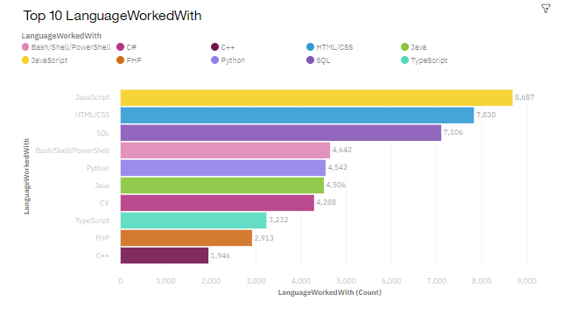
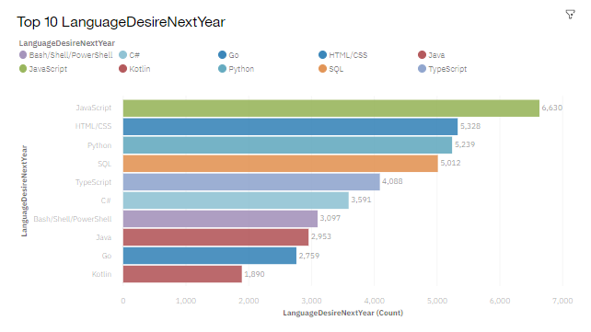
PROGRAMMING LANGUAGE TRENDS
Current Year
Next Year

Slide 8
PROGRAMMING LANGUAGE TRENDS - FINDINGS & IMPLICATIONS
Findings
JavaScript, Html and CSS are the on top and will be at the same place.
SQL is top 3 and will not see any declines.
Python moderately used language but it will see a large up rise in the future.
Implications
Web-designers will still be in high demand.
SQL Individuals should continue learning SQL, It’s still a valuable skill.
Businesses and individuals should start working with python and more and more python developers will be in high demand in the future.

Slide 9
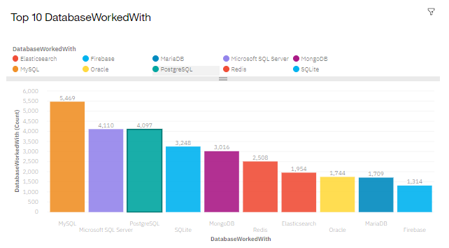
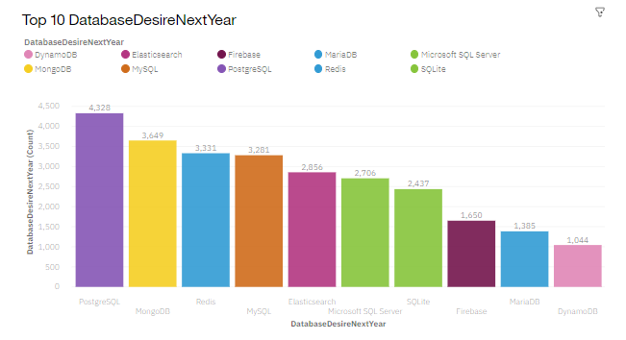
DATABASE TRENDS
Current Year
Next Year

Slide 10
DATABASE TRENDS - FINDINGS & IMPLICATIONS
Findings
MySQL is at the top because It’s Open-source DBMS.
Microsoft SQL Server will see a decline in future.
PostgreSQL might be at the top used DBMS next year.
MongoDB and Redia will see a large up rise in their place.
Implications
MySQL might not be at the top in the future but still be moderately used DBMS.
Businesses and software firms are advised to take action for the future change.
NoSQL databases like MongoDB will make a large impact on datebases lineup.

Slide 11

DASHBOARD
Click here for Dashboard Link

Slide 12
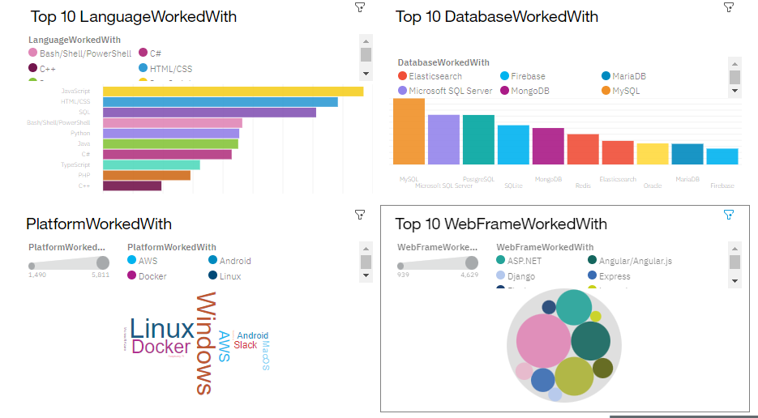
DASHBOARD TAB 1

Slide 13
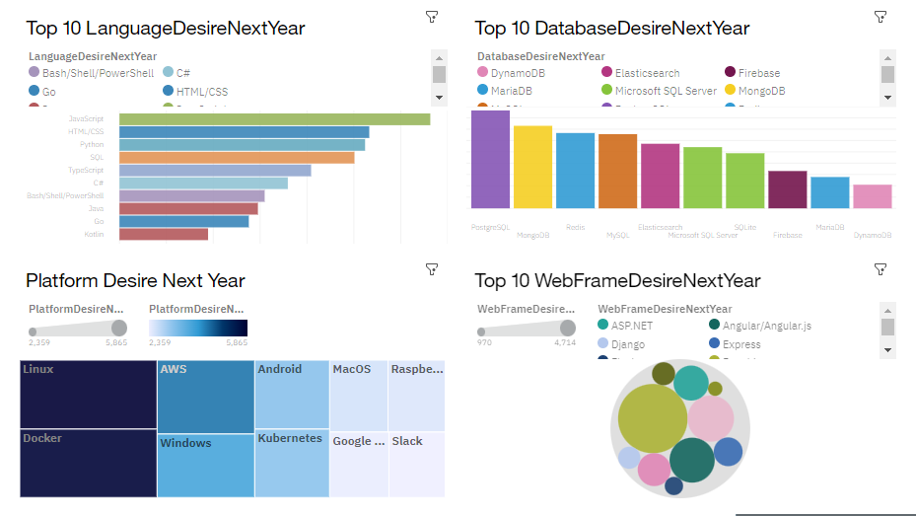
DASHBOARD TAB 2

Slide 14
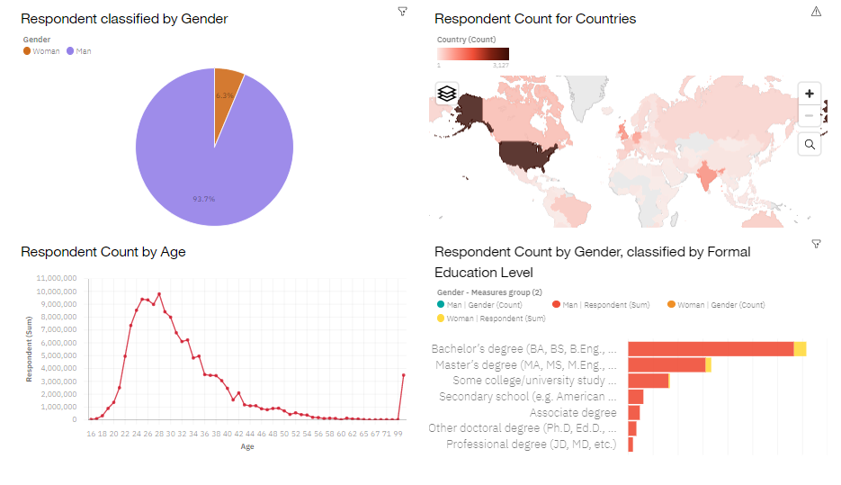
DASHBOARD TAB 3

Slide 15
DISCUSSION

Slide 16
OVERALL FINDINGS & IMPLICATIONS
Findings
Programing Languages: JavaScript, HTML/CSS, Python & TypeScript will see a large Up-Rise.
DataBases: PostgreSQL, Redis and MongoDB are growing fast as ever.
Platforms: Linux, Docker and AWS are increasing passing through Windows.
Web-Frames: JQuery is not the favorite anymore, It will see a large decline. React.Js growing moderately with Vue.Js fast as ever.
Implications
Developers need to learn more skills like python and TypeScript to stay competitive.
NoSQL Databases are on Rising Boom.
Linux seems to be the future of platforms and Ignore docker, AWS, Kubernetes and slack will be a big mistake.
Developing skills for React.Js and Vue.js is a must but ASP.net and Angular will be still moderately used.

Slide 17

CONCLUSION
Tech Industry is growing as fast as ever, Learning technologies is a must for future developers to stay competitive.
Those having the old skills must learn new skills and technologies or they will be replaced.
Businesses have to change with technologies.

Slide 18

APPENDIX
To get the annual salary for the programming languages, Data is scrapped from Github Jobs API.

Slide 19
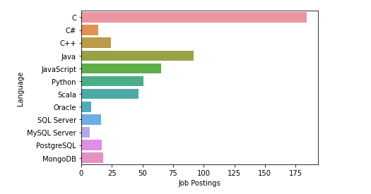
JOB POSTINGS

Slide 20
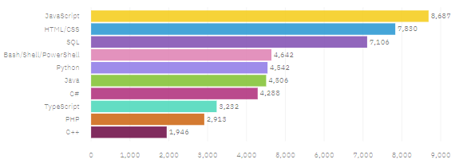
POPULAR LANGUAGES

